Slide 1
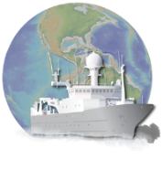




Semantics for Science Part 1: WHY?
Cynthia L. Chandler, Adam Shepherd, Robert A. Arko Matthew B. Jones and Douglas Fils
http://bit.ly/S4S2017
Semantics Symposium Bethesda, MD 10 January 2017
Notes:
Title: Semantics for Science Part 1: WHY?
Authors: Cynthia L Chandler, Adam Shepherd, Robert Arko, Matthew B. Jones and Douglas Fils
Part 2 HOW? Presented by Adam Shepherd
20 minute presentation
Semantics Symposium
Bethesda, MD
10 January 2017

Slide 2
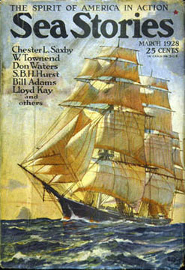
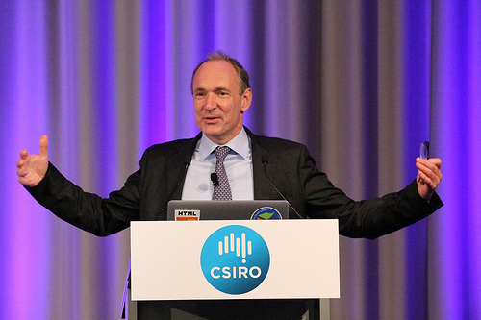
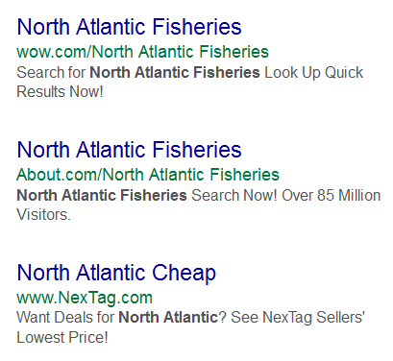


Sea storY: part 1
R2R
Notes:
In the great tradition of mariners, I will share a sea story … in 2 parts
First the why – the science needs, and then Adam does the technical bits in part 2 (what we did and how)
Tim Berners-Lee said ‘the Internet is this big’
But when we search for topics of interest to marine scientists the search results are not ideal

Slide 3
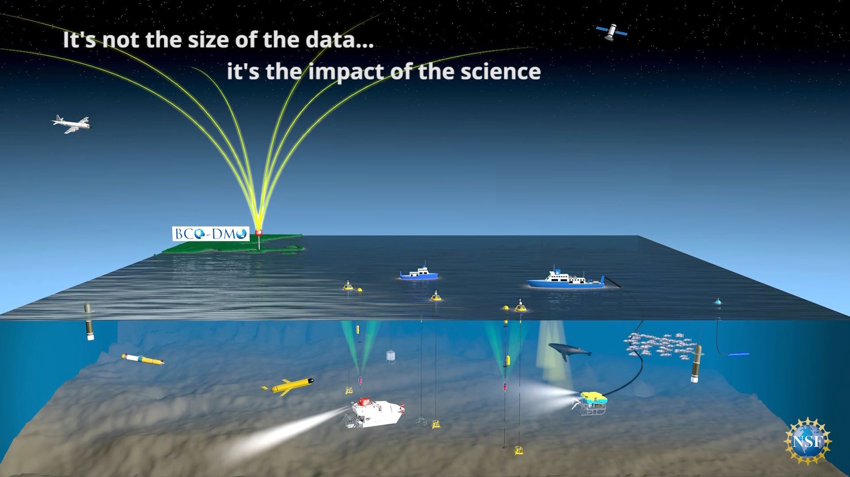

distributed data … global science
R2R
Notes:
A typical marine research program of today involves sampling programs at sea supplemented by laboratory or mesocosm research. In addition to the variety of sensors and instrumentation deployed from the research vessel, the at sea field program includes sampling from a variety of platforms including floats, gliders, manned and unmanned vehicles, autonomous sensor systems and moored systems.

Slide 4
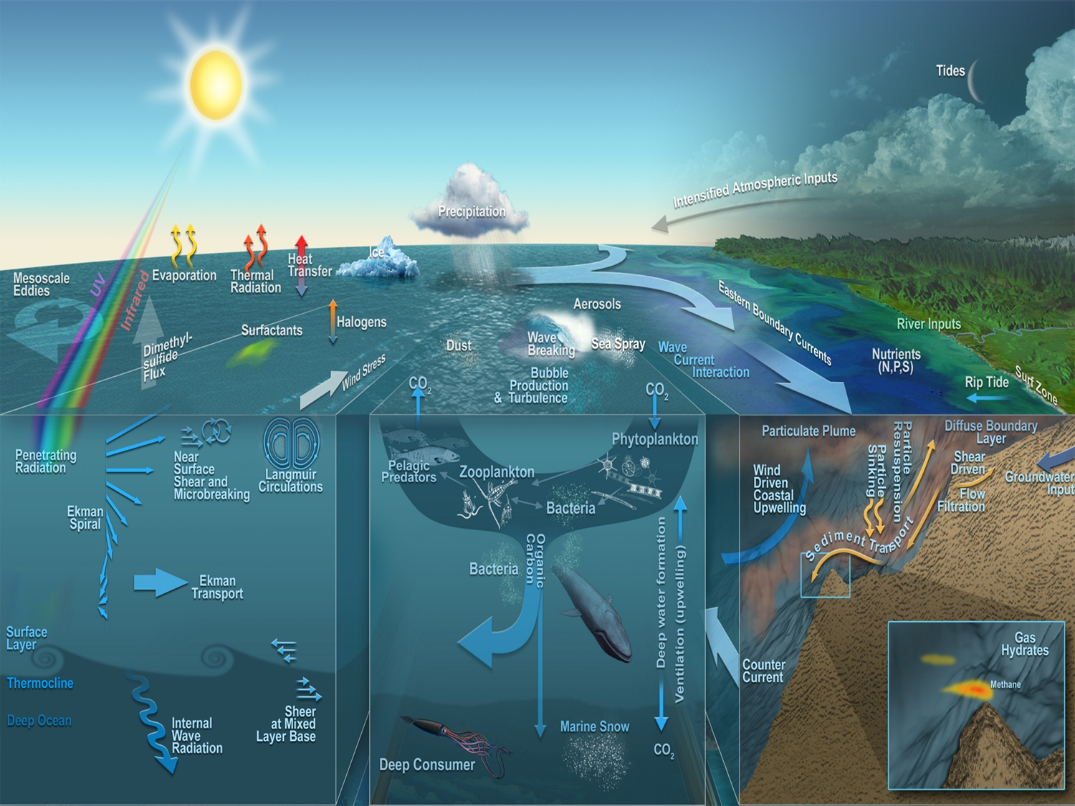
(Jack Cook, WHOI, 2012)
Notes:
Atmosphere-Ocean Coupling
Ocean circulation and ecosystems and coupling with seafloor
Graphic by Jack Cook, WHOI, 2012

Slide 5
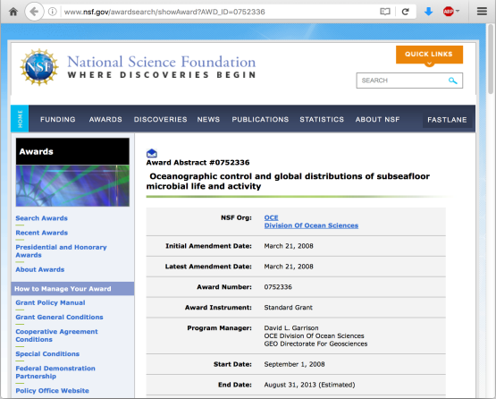
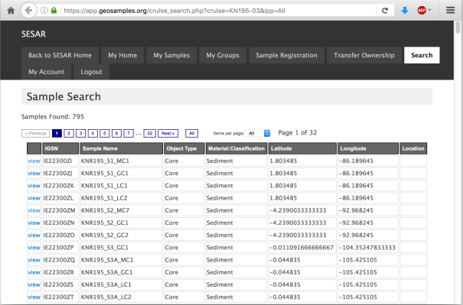
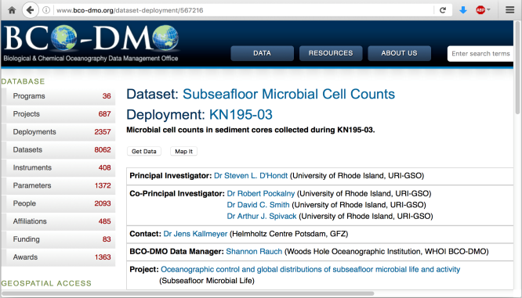
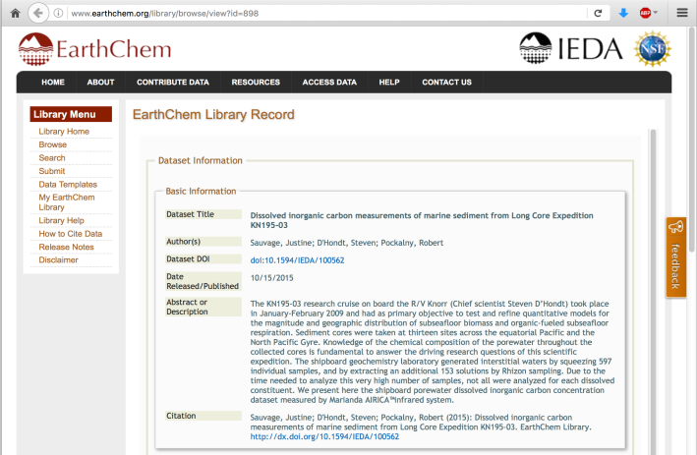
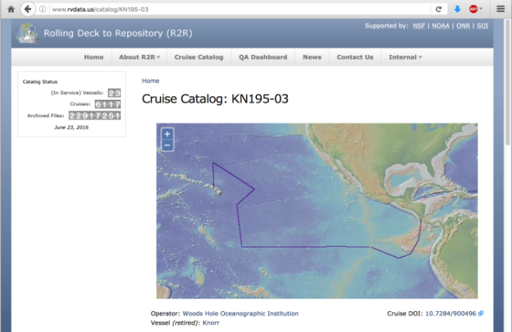
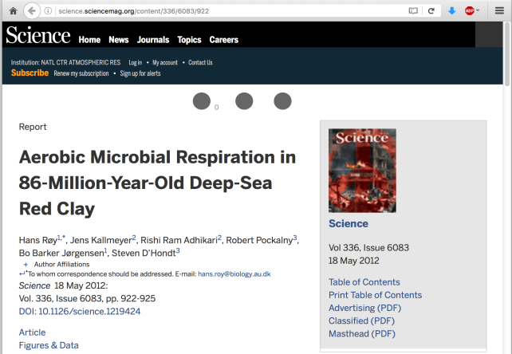
Distributed Related Resources
Funding Source
Physical Samples
Data Sets
Field Expedition (e.g. cruise)
Publications
Notes:
Curation experts at each repository have enhanced the data object with metadata; structured information that can be used to connect that research result with others to form the full set of data and publications resulting from that research project.

Slide 6

R2R, Bco-dmo, DataONE
R2R provides stewardship of routinely-acquired environmental sensor data from U.S. academic research vessels, and a catalog of cruises
BCO-DMO works in partnership with NSF-funded researchers to help improve access to marine research data some of which is acquired during research cruises
DataONE is a global network that federates content from many repositories including R2R and BCO-DMO
Repositories funded primarily by U.S. National Science Foundation with additional support from NOAA, ONR, GBMF and SOI
Notes:
The BCO-DMO staff members work closely with teams of investigators funded by NSF OCE and Polar Programs (PLR) awards to ensure that data collected during their research endeavours are made available to the broader research community.

Slide 7
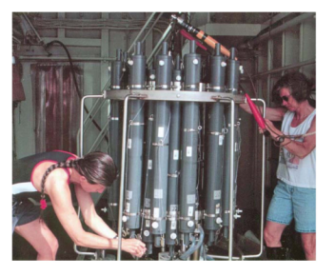
Free text Metadata – not enough
Found we needed to disambiguate as much of the metadata content as possible.
Sufficient metadata is essential but plain text metadata is not enough. Semantic Web technologies help to improve discovery and access.
Notes:
Update photos to match Bob Arko’s example
Researchers used instruments to collect data during the cruise
Data published with a DOI
we are leveraging Semantic Web technologies to enhance the cyberinfrastructure
that supports marine research community, to enable researchers to tackle complex, global research
questions such as those enabling sustainable fisheries science, or coastal and marine ecosystem studies
that contribute to better informed management decisions, and climate change vulnerability and potential
mitigation.
Credits: WHOI Image Database; images contributed by Woods Hole Oceanographic Institution personnel or those who have sailed on one of our vessels.

Slide 8




Persistent identifiers
Current practices in U.S. ocean science:
DOIs for Articles
DOIs for Datasets
DOIs for Documents
FundRef codes for Awards
IGSNs for Samples
ORCIDs for Persons
(Hanson, 2016; 10.1029/2016EO043183)
Notes:
Publish data sets as Linked Open Data in with standards-compliant, machine-interpretable metadata

Slide 9
Persistent identifiers
Emerging practices in U.S. ocean science:
GRID IDs for Organizations
DOIs for Collections (package of objects)
DOIs for Repositories (via RE3data.org)
DOIs for Expeditions (via e.g. R2R, IODP)
DOIs for Networks (via e.g. FDSN)
Shared notes: http://bit.ly/S4S2017
Notes:
network codes are assigned by the FDSN archive (IRIS DMC) to disambiguate seismological data streams

Slide 10
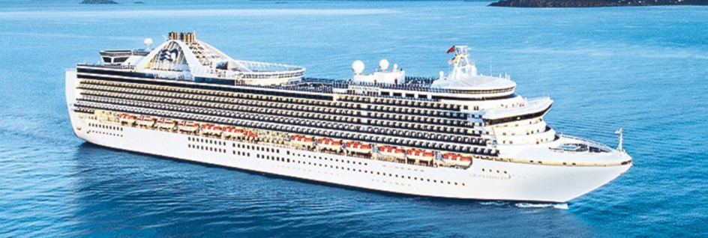
Progress so far . . .
Metadata, plus
Semantic markup, plus
Persistent identifiers . . .

Slide 11
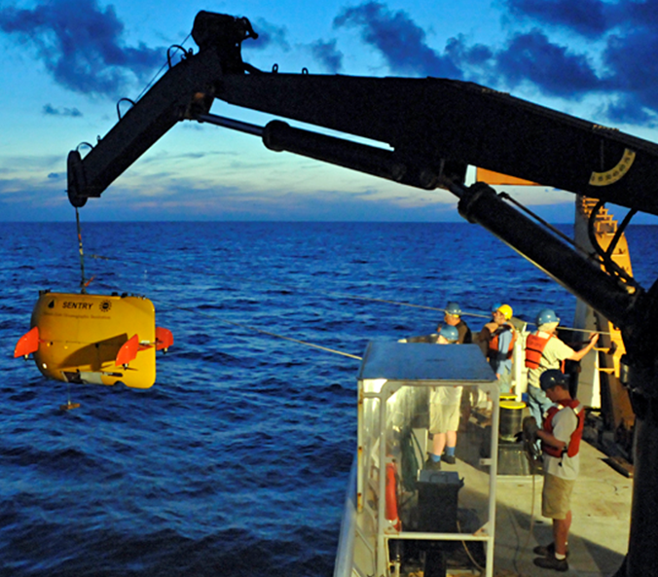
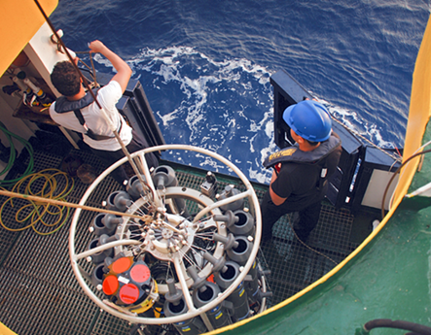
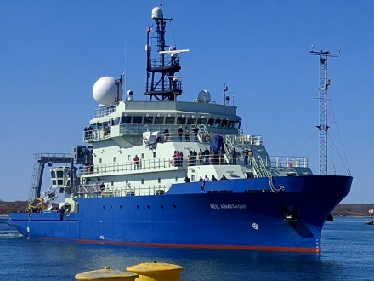
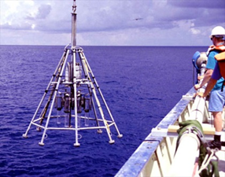
Progress so far . . .
Metadata, plus
Semantic markup, plus
Persistent identifiers . . .

Slide 12
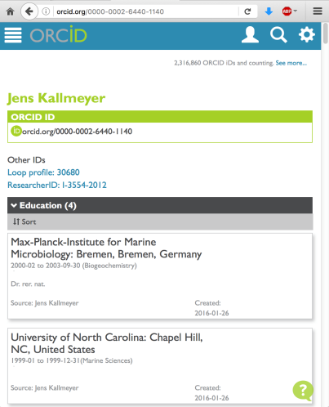

Linking Related Resources via PIDs
Person @ORCID
Cruise @R2R
Award @NSF
Paper
Samples @SESAR
Dataset @ECL
Dataset @BCO-DMO
Notes:
Curation experts at each repository have enhanced the data object with metadata; structured information that can be used to connect that research result with others to form the full set of data and publications resulting from that research project.
If a repository doesn’t publish out their content as Linked Data then GeoLink can harvest and republish a subset of that content as Linked Data, using the GeoLink modular ontologies to harmonize the content.

Slide 13

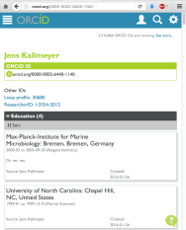


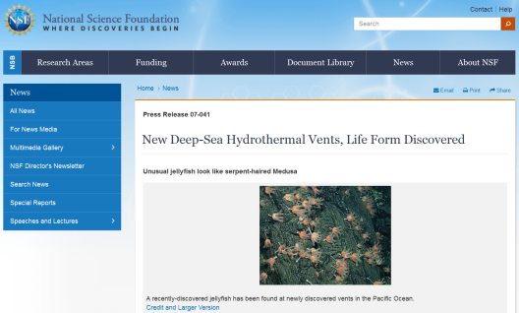
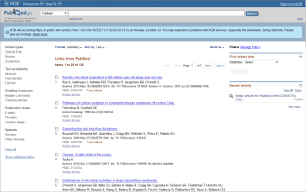
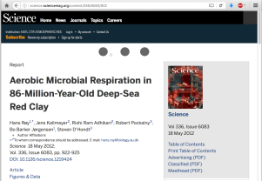
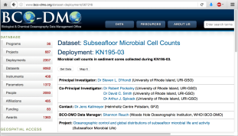

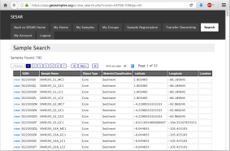

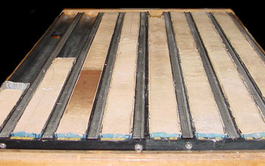
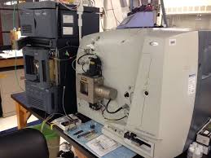
Linking Additional Resources
educational history
research vessel information
related research
related articles
photos of cores
related analyses
instrumentation details
Notes:
Having linked the primary object (information types) we can access related information by following links to additional resources.

Slide 14
GEOLINK … and beyond
Use ontology design patterns
Controlled vocabulary term URIs (PIDs)
Promote ORCiDs (person) and DOIs
Publish more resources as Linked Data from other repositories
BCO-DMO Linked Data <ISO 19115, term URIs, links to other term URIs>
GeoLink ontology patterns: http://schema.geolink.org/
Notes:
GeoLink using ODPs to harmonize content across repositories
Globally unique persistent identifiers aid with disambiguating instances of important concepts (which Dave Johnson? The one at Harvard doing research on the iron cycle in the marine environment?)
ORCiD = Open Research and Contributor ID http://orcid.org
Funding Data (service; previously FundRef from CrossRef) PIDs for funding source organizations

Slide 15
Linked data + ISO 19115
BCO-DMO publishes metadata out as Linked Data.
RDF with persistent identifiers (e.g. ORCID for person, and DOI for cruise)
Link to the full ISO 19115 record
http://lod.bco-dmo.org/id/dataset/3045.rdf
<rdf:Description rdf:about= "http://lod.bco-dmo.org/id/dataset/3045#iso">
<rdfs:seeAlso rdf:datatype= "http://www.w3.org/2001/XMLSchema#anyURI"> http://www.bco-dmo.org/dataset/3045/iso </rdfs:seeAlso>

Slide 16


Thank you
GeoLink Partners:
Representing: Marine Sciences, Library Sciences, and Computer Sciences
Woods Hole Oceanographic Institution
Cynthia Chandler
Adam Shepherd
Peter Wiebe
BCO-DMO staff members
Marymount University
Tom Narock
University of CA, Santa Barbara
Matt Jones (NCEAS, DataONE)
Yingji Hu, Bryce Mecum
Krzysztof Janowicz
Mark Schildhauer
Lamont-Doherty Earth Observatory
Robert Arko, Peng Ji
Suzanne Carbotte, Kerstin Lehnert
MBLWHOI Library
Lisa Raymond, Audrey Mickle
Wright State University
Pascal Hitzler
Michelle Cheatham
Adila Krisnadhi
Ocean Leadership: Doug Fils
Notes:
Using semantic web technologies to enable machine-to-machine interoperability through “smart data”
Teams of researchers representing: data repositories, libraries, computer science labs and marine science domain experts
Research funded by: NSF OCE-1435578 (BCO-DMO), ICER-1440114 (R2R), OCE-1447797 (EarthCube GeoLink), DataONE, IODP

Slide 17
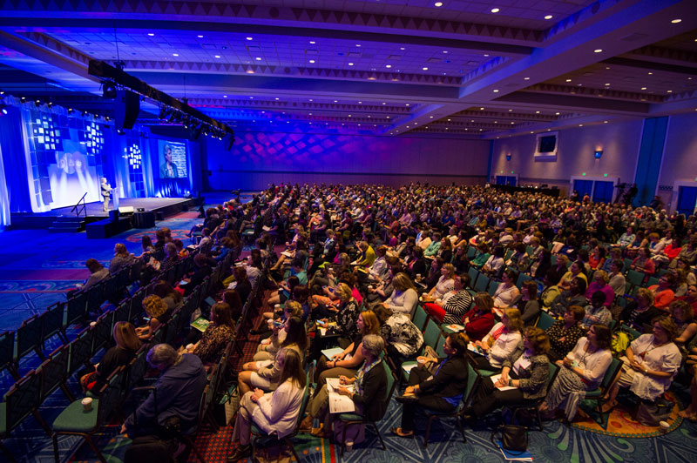
Audience participation
Notes:
Image: 3 October 2016 Gordon Barker
http://www.epnetstreaming.co.za/how-much-should-a-professional-produced-live-streaming-webcast-cost/
Google doc: S2S2017
Or use MeeToo or Poll everywhere?

Slide 18
challenges
What other ways are people using semantics to meet information management challenges?
Provenance?
Shared notes: http://bit.ly/S4S2017

Slide 19
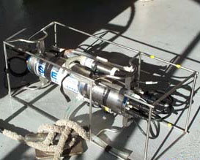

consideration
Should we publish PIDs for controlled vocabulary terms?
e.g. classes of instruments
sameAs
Shared notes: http://bit.ly/S4S2017

Slide 20
Extra slides – PID semantics

Slide 21
consideration
What other PID systems are in use?
Shared notes: http://bit.ly/S4S2017

Slide 22
CHALLENGE
DOIs issued for multiple copies – different instances of same content
e.g. same data at many repositories
copies of the same data set could appear in many repositories, with different metadata as determined by the repository practices, with each repository assigning a new DOI; in many cases the repositories may not be aware that the data have already been published by another repository
Shared notes: http://bit.ly/S4S2017

Slide 23
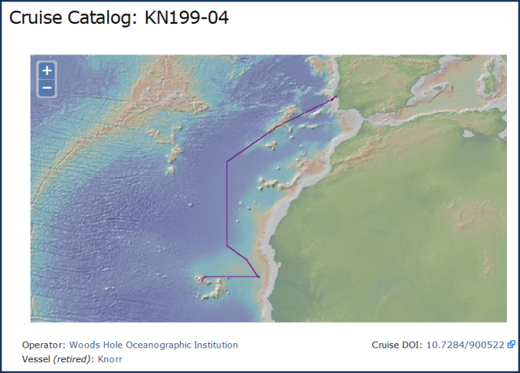
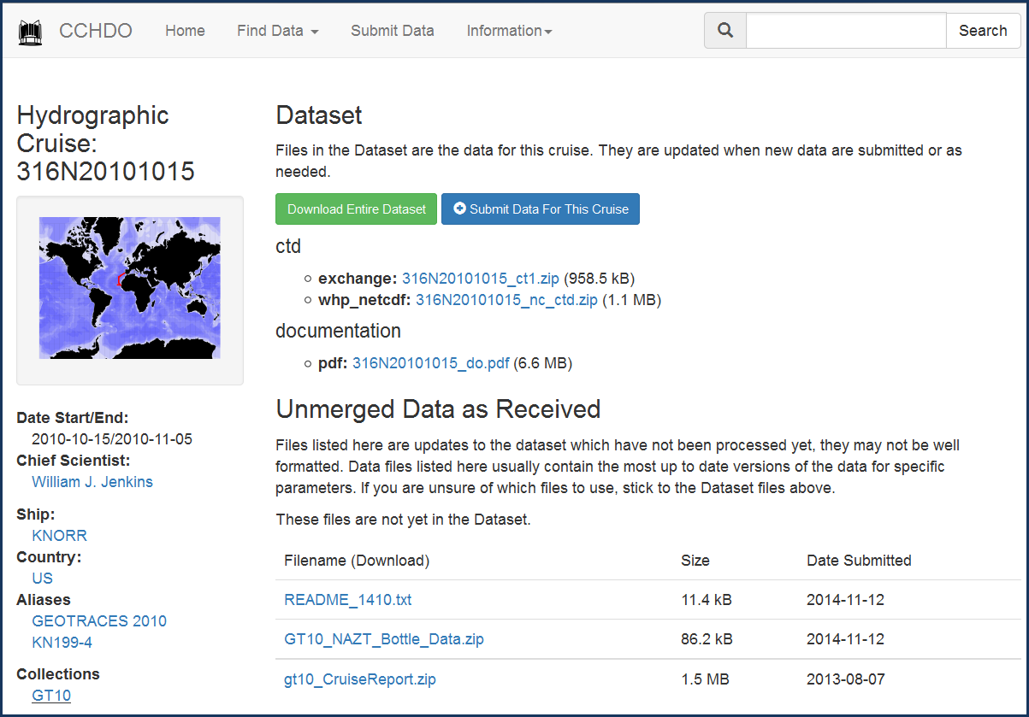
CONCERN
DOI assignment practices
e.g. assign DOI for an event as well as collection of results from an event; is there a recommended practice for citation?
Assign a DOI to the metadata record for a sampling event (e.g. cruise)
Assign a DOI to the collection of all data sets and documents at a repository that are associated with an event

Slide 24
challenge
"upstream/downstream" issue
Are there recommended practices for encoding provenance using PIDs.
Datasets pointing to parent event.
Articles reference datasets.
ORCiD points to projects.
Shared notes: http://bit.ly/S4S2017
Notes:
Does BCO-DMO update its Dataset DOIs to point upward at the R2R Cruise DOIs?
Or does R2R point downward to BCO-DMO?
Does IEDA update its DOI (for the GMRT synthesis product) to point upward
at the R2R DOIs (for the original multibeam datasets)?
Or does R2R point downward to IEDA?

Slide 25
challenge
Granularity of DOI assignment: DataCite expects DOI PIDs to represent a data set (e.g. with a title), whereas we need PIDs both for that and for components of data sets such as individual files, granules, and records. e.g. use UUIDs for internal components of data sets, and assign the DOI to the whole data set.
There could be good reason for DOIs to be assigned to more granular components. In general, the PID community has not embraced the need for PIDs at multiple levels of the data hierarchy (cell, record, file, metadata, package).
Shared notes: http://bit.ly/S4S2017

Slide 26
challenge
Person IDs: ORCIDs working great for extant people, still challenged on how to assign person identifiers for all of our historical data records (e.g. people who have moved on to other fields)
Shared notes: http://bit.ly/S4S2017

Slide 27
concern
If a dataset or document isn’t published with a DOI, does it exist?
Will non-DOI’d content be discoverable by emerging networks like CrossCite tool, Scholix, etc?
Shared notes: http://bit.ly/S4S2017

Slide 28
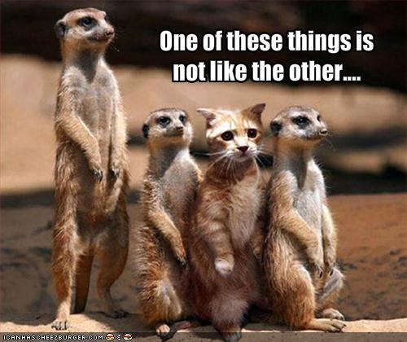
concern
A DOI is a DOI … or are CrossRef and DataCite data set DOIs different ?
One of these things is not like the other …
but is there a lossless crosswalk between their metadata schemas?
Shared notes: http://bit.ly/S4S2017

Slide 29
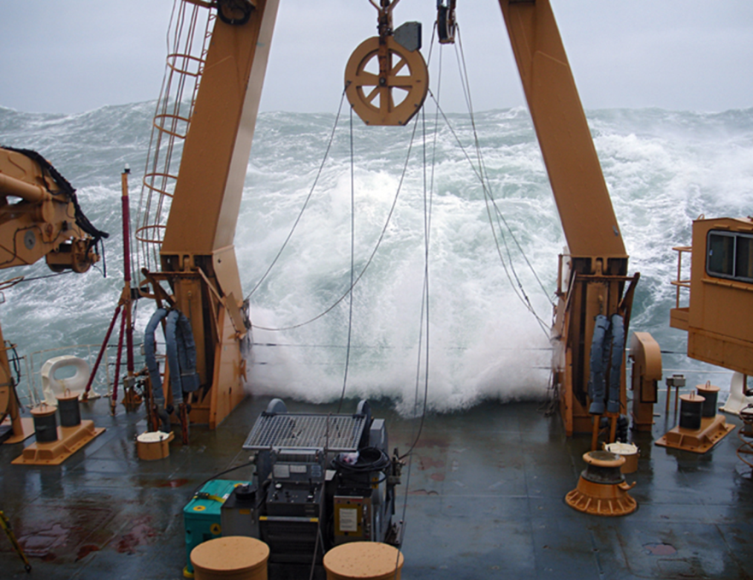
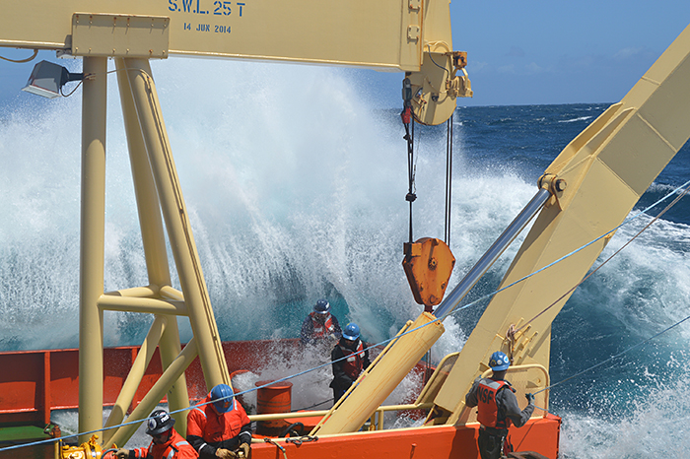
Thank you
Research funded by: NSF OCE-1435578 (BCO-DMO), ICER-1440114 (R2R), OCE-1447797 (EarthCube GeoLink)
DataONE: http://dataone.org/
IODP: http://iodp.org/
Notes:
Photo credits:
left: Chris Linder, WHOI, 2009
Right: Mitch Eland, UW, 2015

